Slide 1
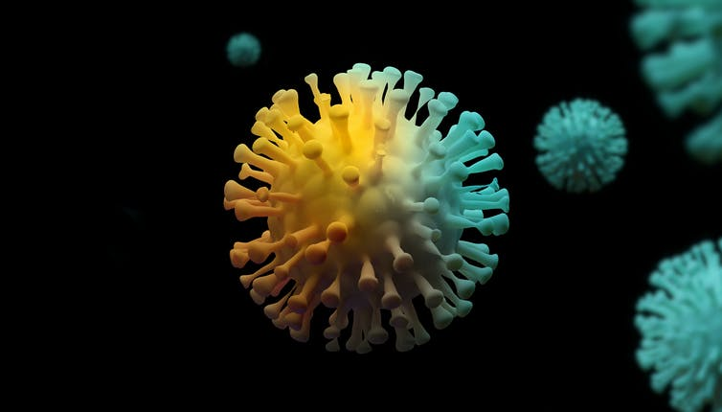
Covid Combat
Presented by: Team Zeta
This Photo by Unknown author is licensed under CC BY.

Slide 2

Problem Statement
AI/ML: 001 (AI Open Innovation)
Covid-19 has plagued the world and has been responsible for lockdowns & isolation across the globe. Despite the decreasing rate of covid-19 cases, we still need to take appropriate precautions when in public places which include: offices, schools and colleges, shopping malls, etc.
Considering this as our base problem, we intend to develop a solution which will address social distancing protocols in public places.
This Photo by Unknown author is licensed under CC BY-SA.

Slide 3
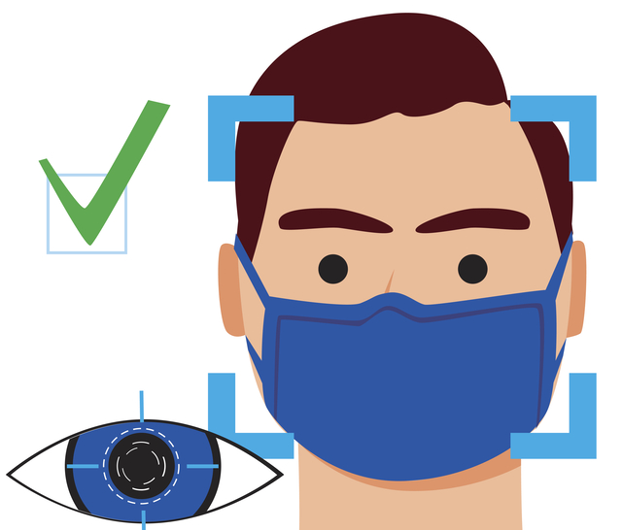
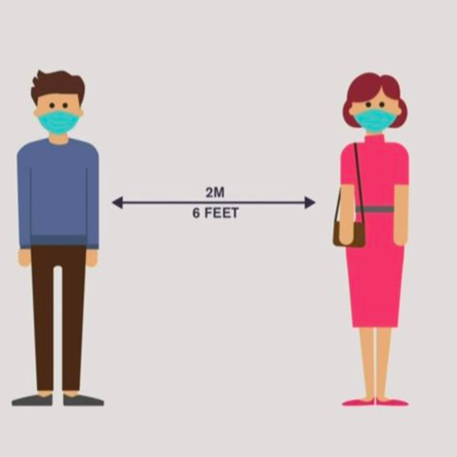
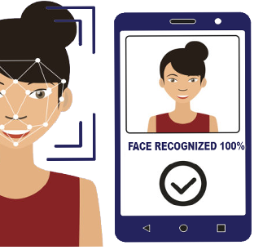
What is Covid Combat?
Covid Combat is a multifaceted social distancing solution which primarily involves three functionalities:
Face Mask Detection
Social Distancing Detection
Facial Attendance and Recognition system
The future plan of this system is to integrate all the three functionalities into a single web based application.

Slide 4



Tech Stack
Python 3.8 Open Source
OpenCV 4.4.0.
Tkinter 0.1.0
YOLO v3
MobileNetv2 pretrained network

Slide 5
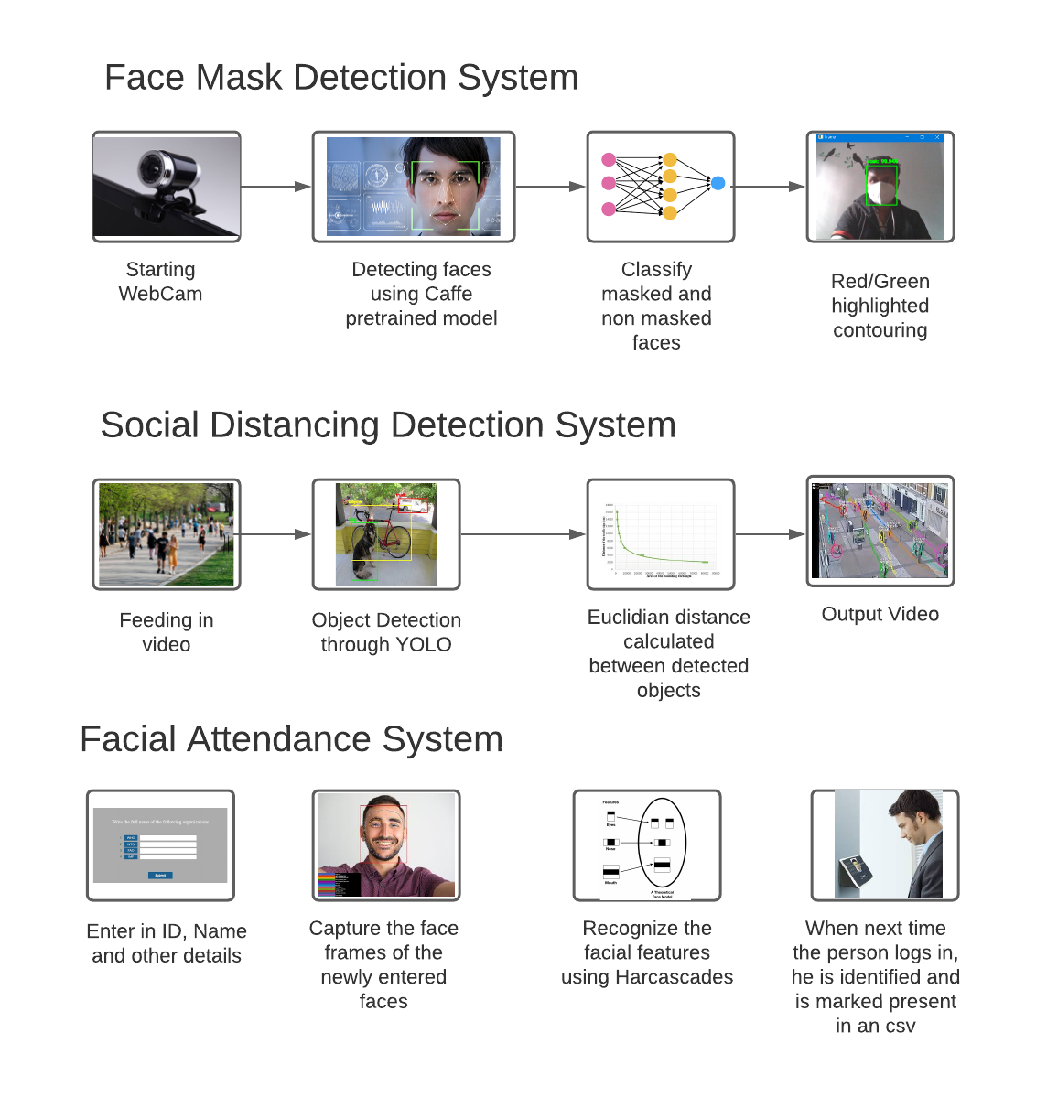
System Flow

Slide 6
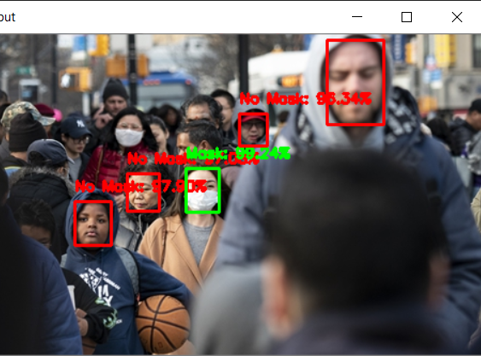
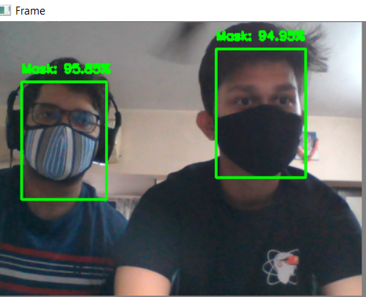
Face Mask Detection
Static Output image: Mask Detection
Screenshot by Webcam: Mask Detection

Slide 7
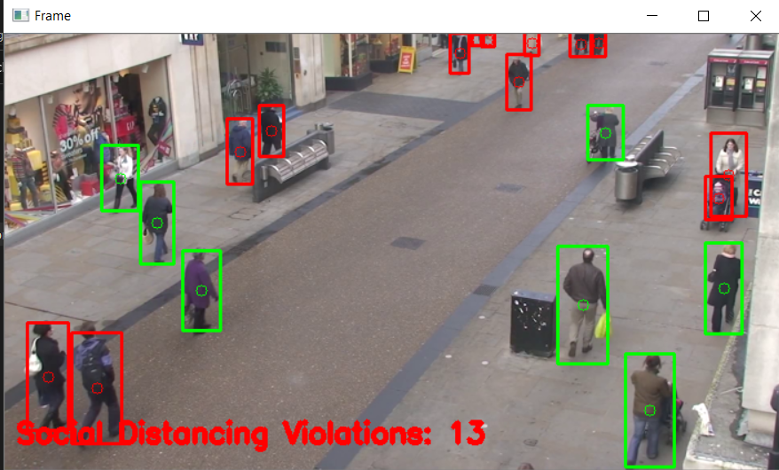
Social Distancing Detection
This live footage was used for generating the output video using YOLO v3 weights and Euclidian distance.
The number of violations recorded is also depicted in the video.

Slide 8
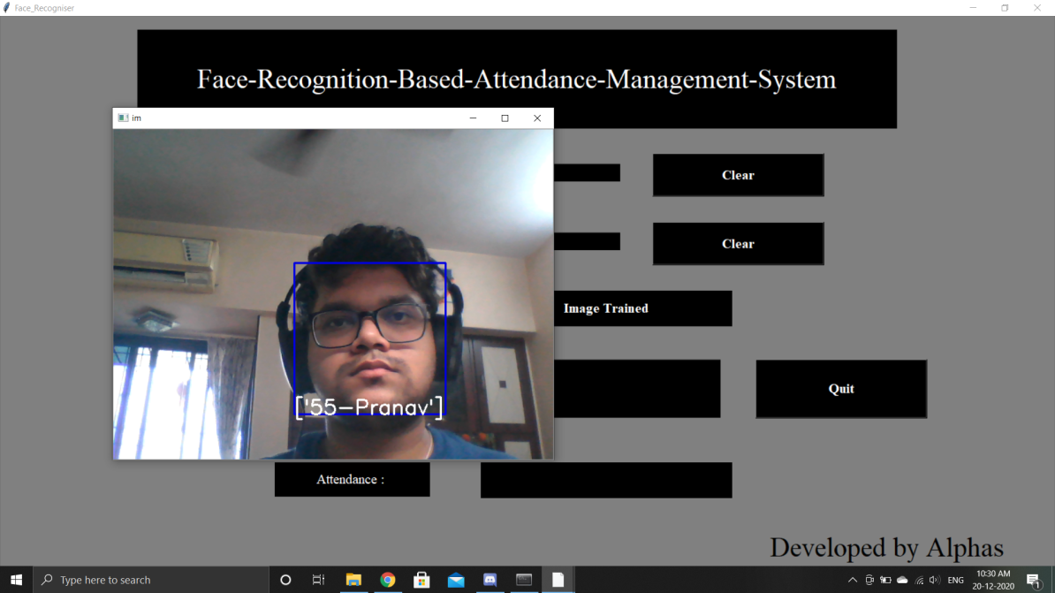
Face Attendance System
Recognized face after training. The attendance is marked for the cognized person and is added into the csv which can be downloaded later.

Slide 9

Project presented by:
Atharva Jibhakate
Pranav Parnerkar
Sahil Mondal

